Slide 1
An Introduction to Microsoft Teams
@JYPhysics

Slide 2
What is Microsoft Teams?
T
Online software that can be accessed anywhere on any device.
Teams = Classes
A way to communicate with your teachers
Share files and work
Notes:
General explanation of what Microsoft Teams is and how it can be used in school

Slide 3
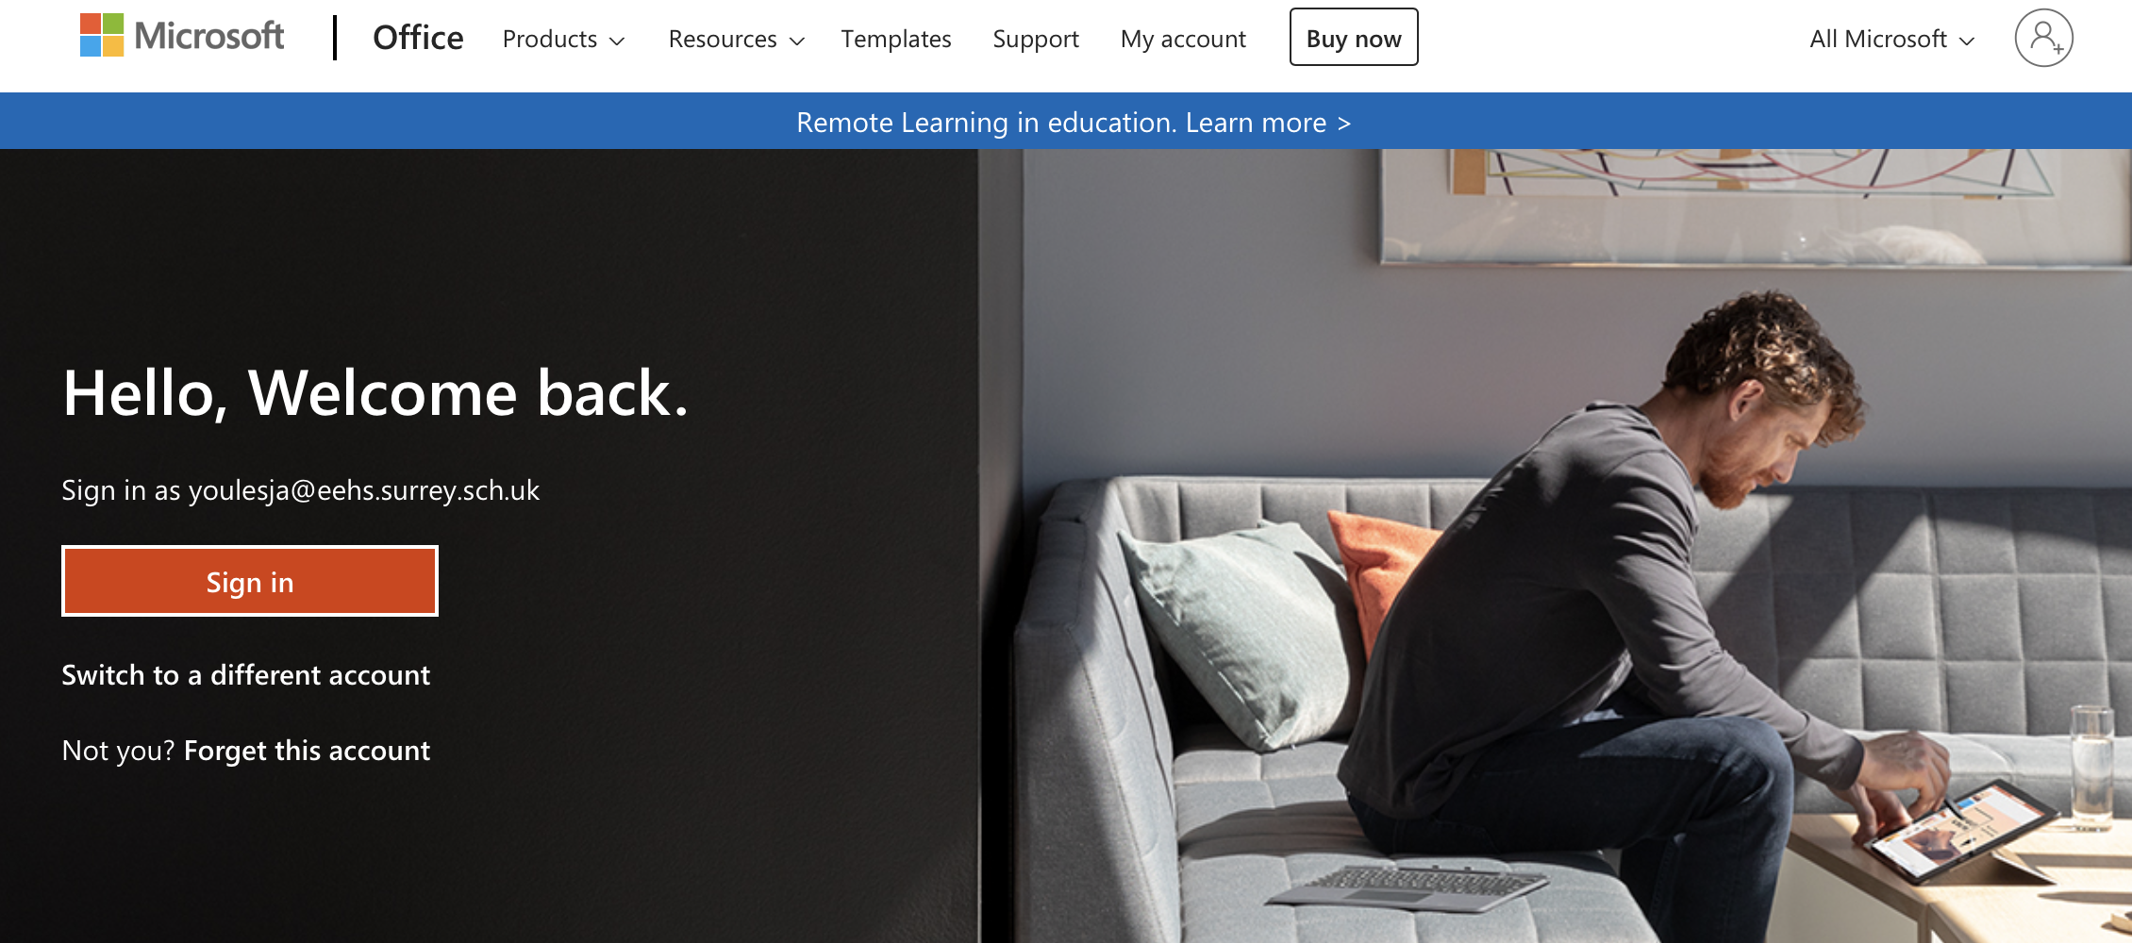
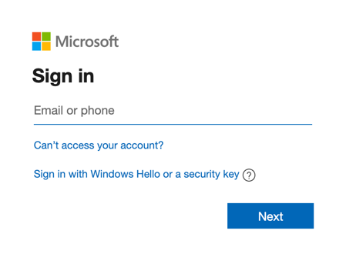
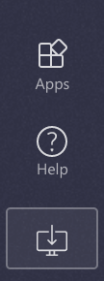
How to access Microsoft Teams
Go to the Office 365 Website
You can then log in with your student Microsoft Account and then select Teams
You can download the app on your devices
Notes:
Explain how to get onto Microsoft teams. The easiest way is the web-app through the school website, but the image on the right shows how students can download the desktop version of the app. Teams is available on both iOS and Android devices. If students are going to use Teams through a web browser, Microsoft Edge and Google Chrome are the best browsers for this.

Slide 4
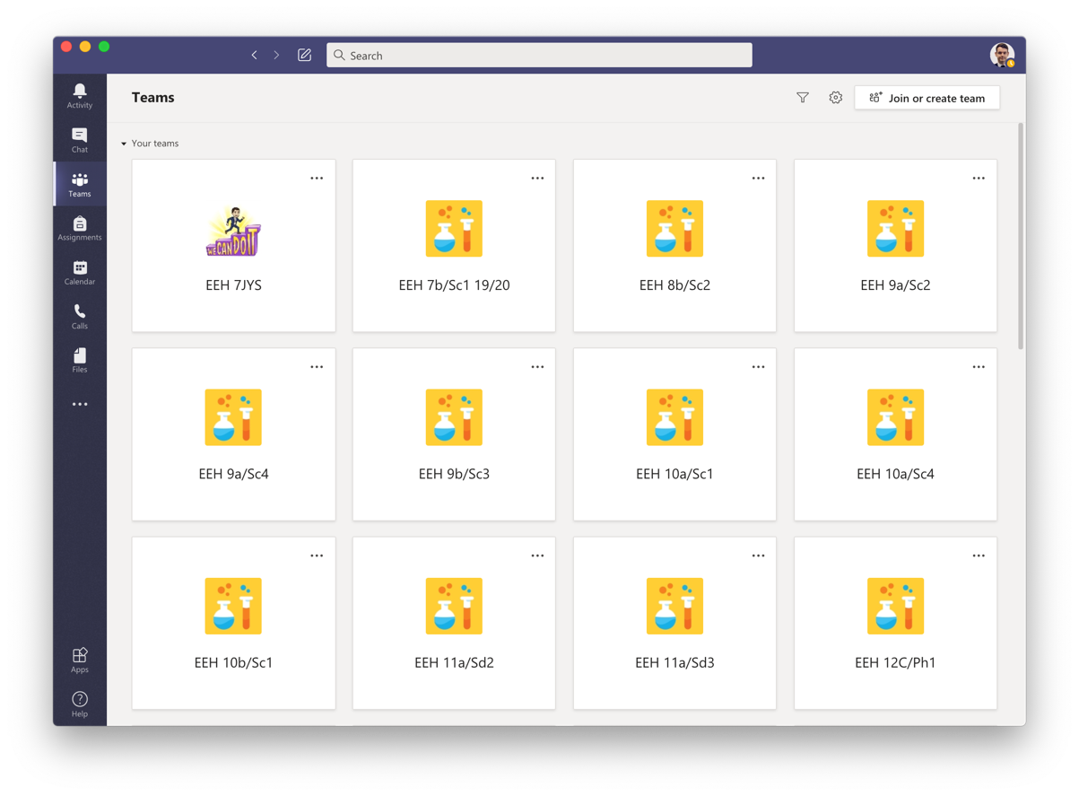
What you will see
Team Icon
7b/Sc1
A grid of your different Teams
You will have a different Team for each of your classes, you may even have classes for clubs!
To open the Team just click on the icon
Notes:
Welcome screen – a grid view of all of the teams a student is in.

Slide 5
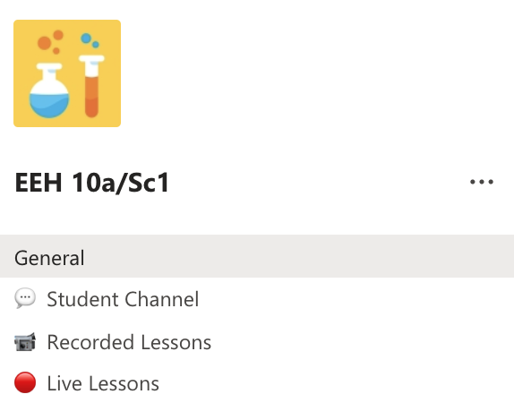
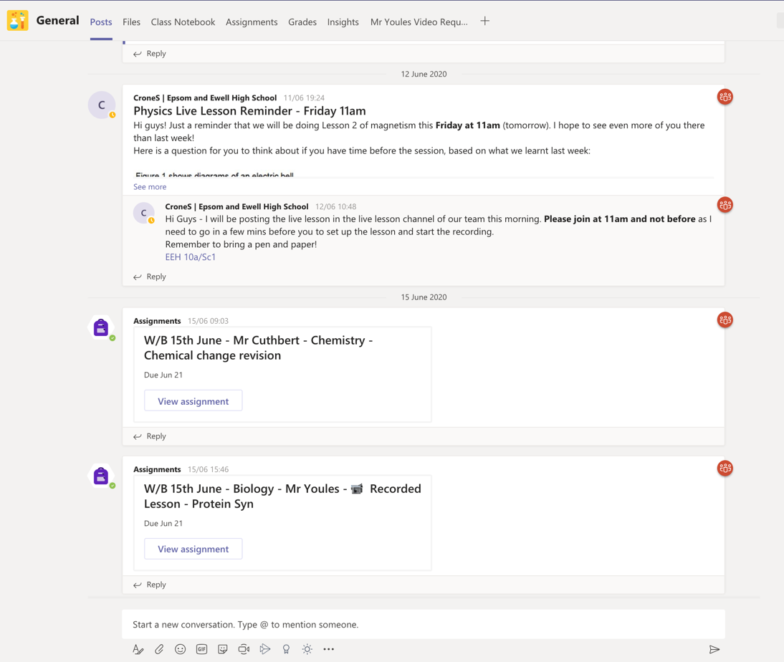
Inside the Team
Team Name
Each Team contains different areas called Channels
In each Channel there are different sections or ‘Tabs’
‘Posts’ is like a big conversation where you can comment on posts
‘Files’ is where your teacher may upload resources
Assignments is where Tasks will be set
Channel Names
Notes:
Explain the different parts to a team – the different channels are like different rooms, with tabs being things in the room – eg the files being a bookcase, assignments; the pile of homework.

Slide 6
Writing a post
You can ask for help in ‘General’ or a dedicated ‘Student Channel’
If you want help you can ask a question to your teacher on Teams.
You can do this in ‘General’ or in a ‘Help’ Channel
If you @ your teacher they will get a notification.
Teacher’s Name
@TeachersName
Smith
If the name is in blue, that person has been mentioned.
@TeachersName will work!
Notes:
How students can mention teachers so that they can ask a message.

Slide 7
Files
Inside the ‘Files’ Tab your teacher may upload documents for you to use.
See the example on the right.
When you find what you are looking for you can download it!
Notes:
How students can find files shared in a team.

Slide 8
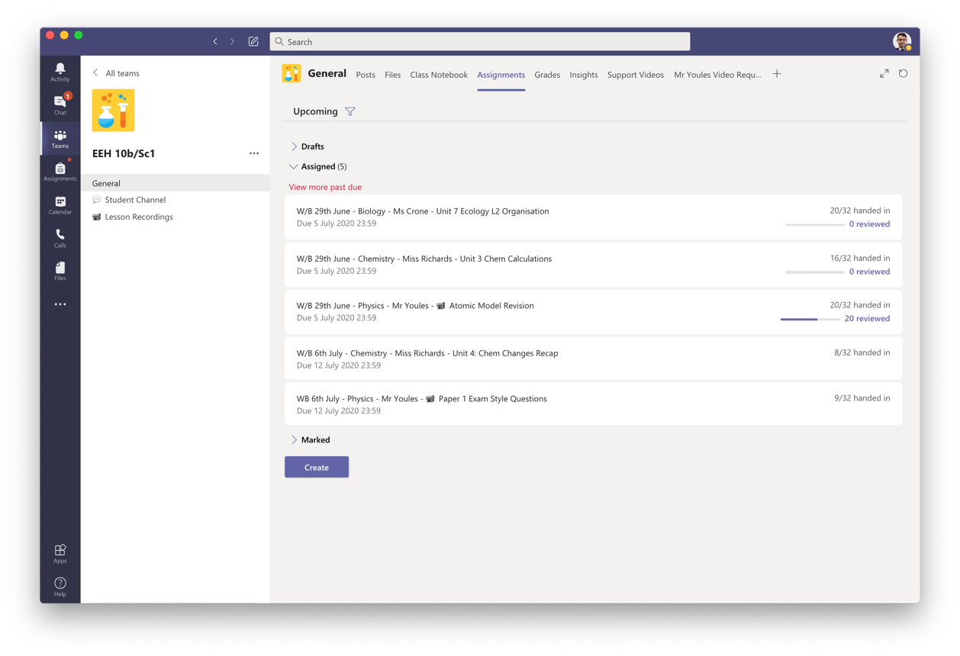
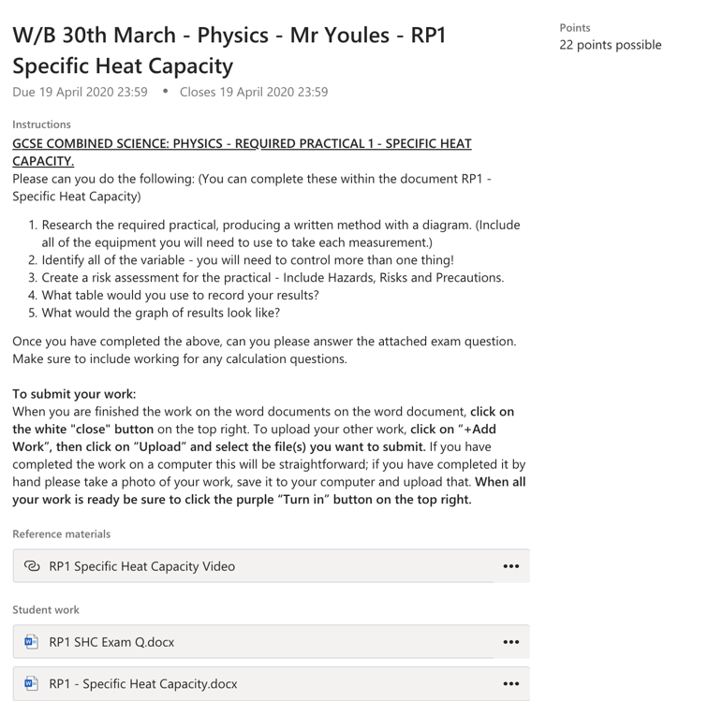
Assignments
When you open the ‘Assignments’ Tab you will see a list of set tasks.
Click on an assignment to see the instructions and attached documents.
Reference Materials
Documents to edit and complete
Notes:
How to open and view assignments

Slide 9
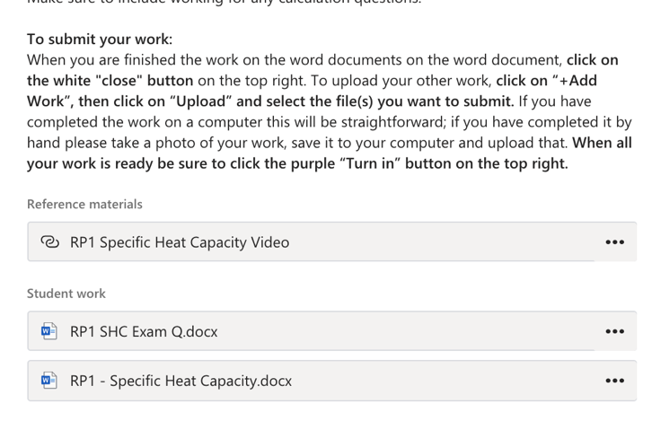
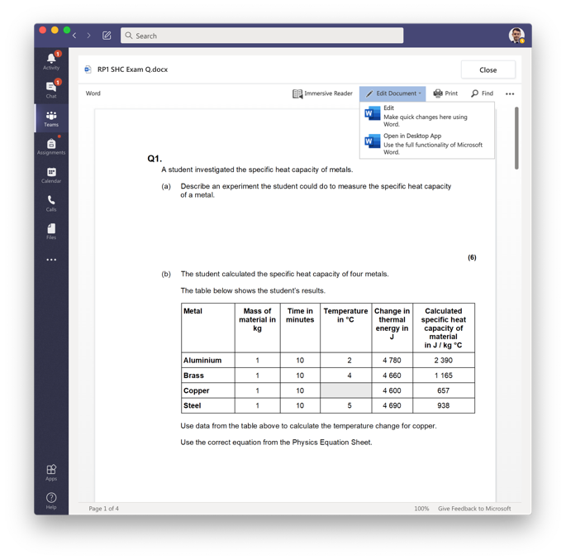
Assignments
Adding work to assignments
Click on + Add Work
Choose the file to upload to the assignment
Often files will be uploaded which you can just click on and edit in Teams and then choose Edit Document
The work will save itself!
Notes:
How to submit work

Slide 10
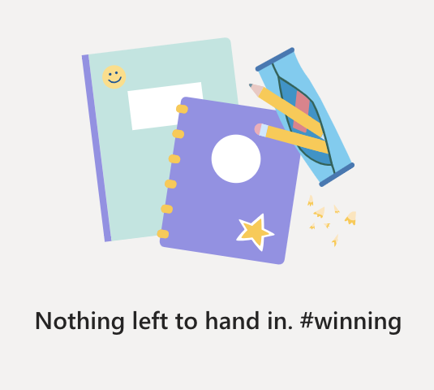
Assignments
Submitting work
Make sure to click Turn In when you have uploaded all your work!
The page will clear when everything is complete #winning
Notes:
How to submit work

Slide 11
Notifications
General Activity – a post has been made or you have been mentioned
Using Teams, you will get notifications for various reasons.
When a new assignment is posted, there will be an @ next to Teams.
If your Teacher makes an announcement you will also get a notification
When work is returned there will be a dot by Assignments
You have a chat message
You have been mentioned in a Team post
Work has been returned
Notes:
What the notifications mean

Slide 12
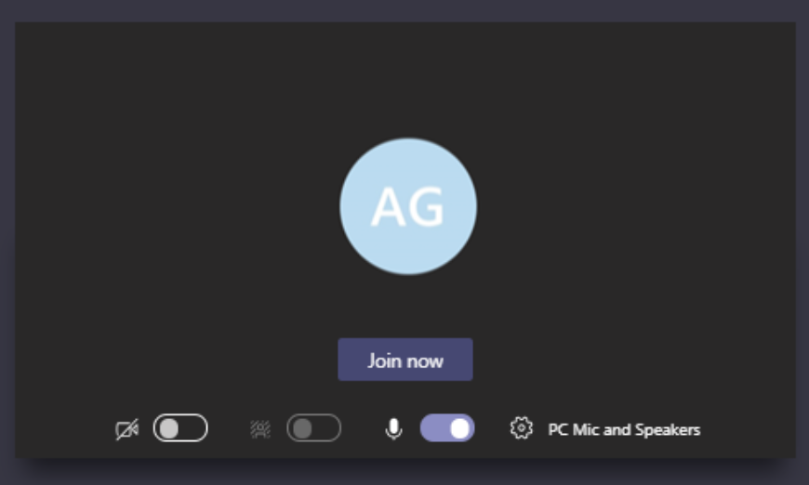
Live Lessons
If there is a Live Lesson there will be a post in the Team.
To join click the purple banner at the start time.
You will then need to join and make sure you have the correct settings!
If you want to ask a question you can use Raise your hand.
You can also type questions in the chat
Then click ‘Join Now’
Make sure your Camera & Microphone are off!
Notes:
Live lessons.

Slide 13
Any Questions?
Notes:
Please email me or teams me with any queries.

